Slide 1

QuizZing
A tool to make your life easier!
Team: Undefined Parameter
Members: Blake Bartlett, Braeden Bodily,
Joseph Lee,
Melynda Lindhorst

Slide 2

Features of QuizZing
Create your own custom study guides
Create your own organizations and groups
Share you study guides with all members
Moderate your own content
Gain contributor status to have more moderation power

Slide 3
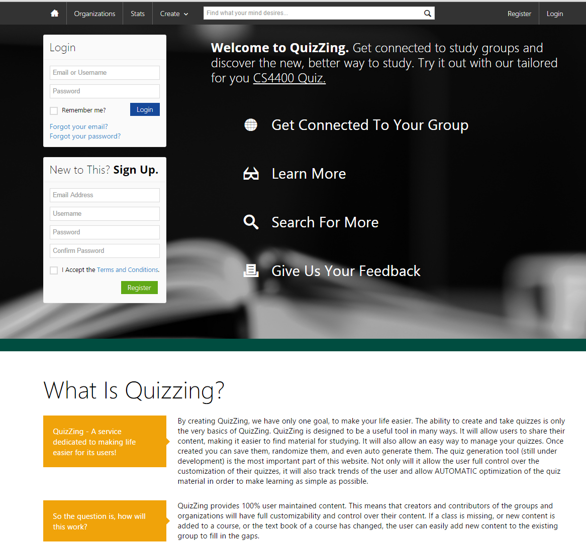
Visit QuizZing at www.myquizzing.com
Our basic features are online and we are ready for you to test it out!
Taking CS-4400? Then visit our study guide. You can even add your own questions to it
Let us know what you think, just select Give Us Your Feedback

Slide 4

Benefits of User Maintained Content
With QuizZing you are able to custom tailor your study guides to your needs.
Incorrect question? Not a problem, as a user moderator you have the power to correct it yourself.
More control in your hands allows the best use experience.

Slide 5
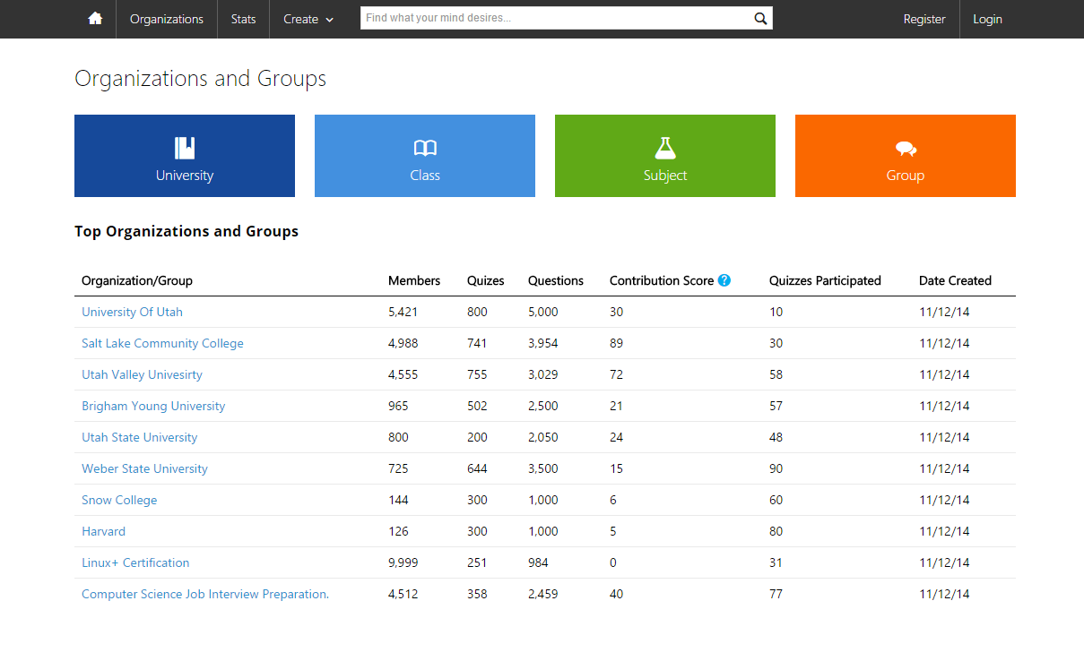
Visit our organizations page
Organizations can be anything from Universities, to friendly groups, certification study guides, or even interview practice
Visit www.myquizzing.com/orgs or click organizations at the top of the page

Slide 6

Soon To Come
User Accounts and Profiles
Even more customization through your own profile
Flag questions and they no longer show up in quizzes
Save your favorite quizzes
Score tracking and analyzation so you can view your progress

Slide 7
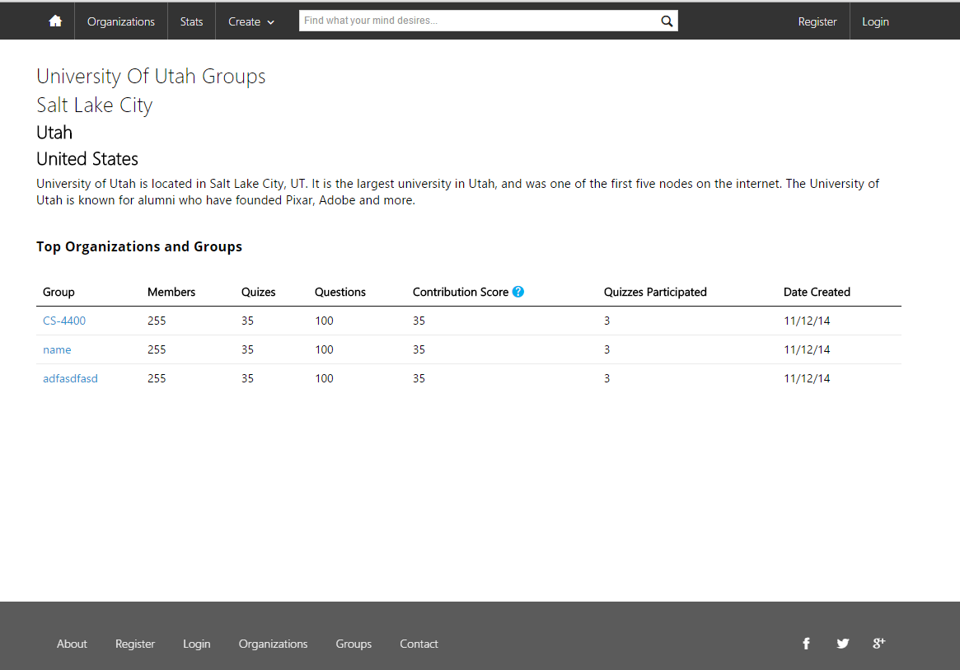
Visit Your Organization Page
While the organization page is still under construction, you can add your own groups for personalized customizability.

Slide 8
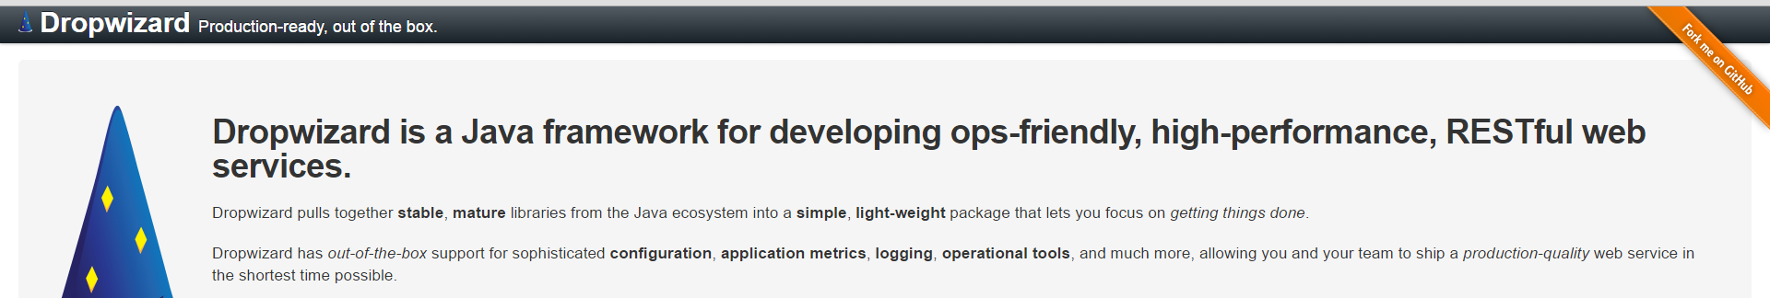
Behind The Scenes
QuizZing is built on the Dropwizard framework.
An amazing tool for building restful services
Production ready
Capable of 50,000 clicks per second
Built in Json formatting
Get more information at dropwizard.io

Slide 9
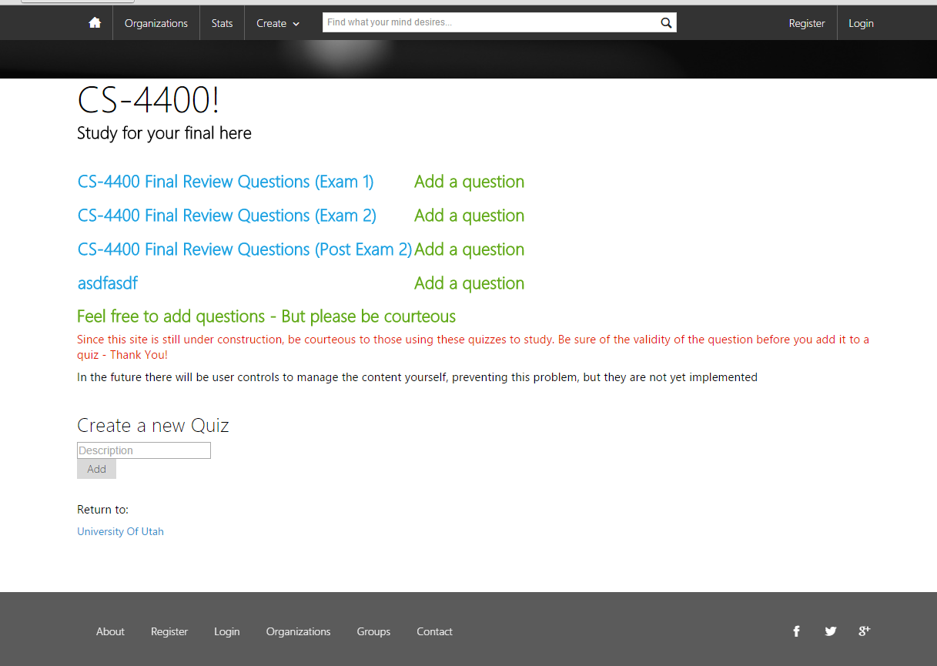
Add Your Own Quizzes
On your group page you can add your own quiz
Once you create a quiz, add your own questions to it

Slide 10

Automatic Quiz Creation
Our goal by final production is to have a single click to generate a quiz
Draws from a pre-existing pool of questions
Can always add more questions later
Can customize after the initial generation
You will also be able to browse existing questions by category and hand pick them for your quiz
The Ratings system will make this process even easier

Slide 11
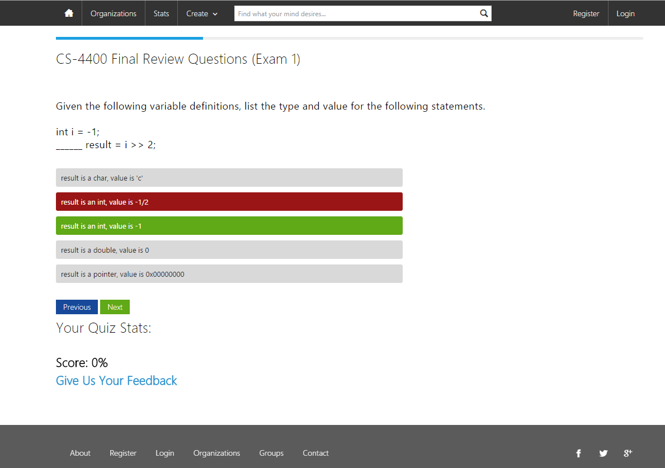
Now Utilize the QuizZing System
Not only can you take the quiz, but you can review it afterwards to see what you missed.

Slide 12
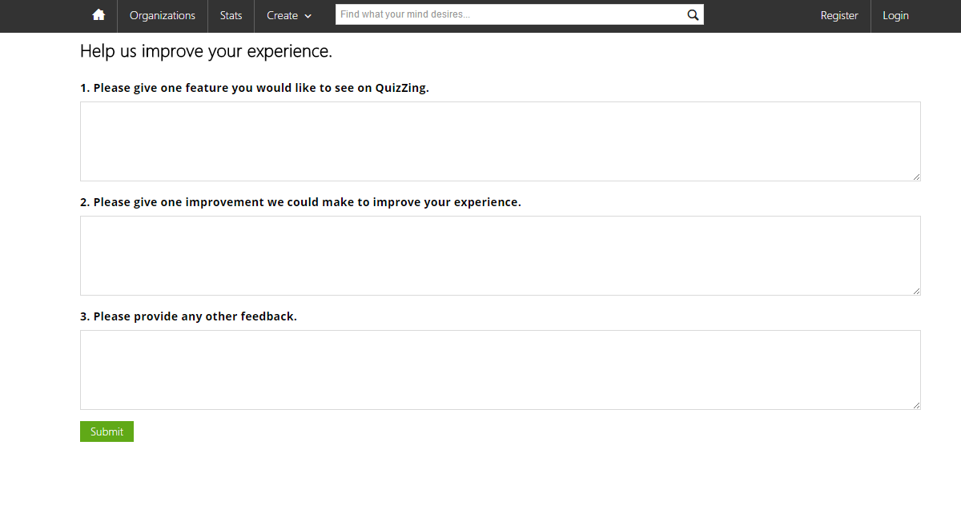
Give Us Feedback
We hope you like what you see so far. Take a minute, visit our site and give us some feedback. Just submit it on our site and it will send it directly to us.

